Slide 1
Python 2
Summer 2020
Brought to you by the Business Career Hub
TRS 2-148 | 416 - 979 - 5106
trsmcareers@ryerson.ca
www.ryerson.ca/trsmcareers
Notes:
[Nel]

Slide 2
Agenda
How we work
Recap
Why Python for data analysis

Slide 3


How we work
What this is:
Interactive session to give you hard skills for interviews and internships/jobs
Expose you to new technologies not in the Ryerson curriculum
What this isn't:
Livestream
YouTube video
Notes:
They are available to inspire future learning

Slide 4
Why Python?

Slide 5
Why Python
Pros:
Lots of tools available in the Python community
Much lower learning curve compared to other programming languages
Cons:
Learning curve
Notes:
They are available to inspire future learning

Slide 6
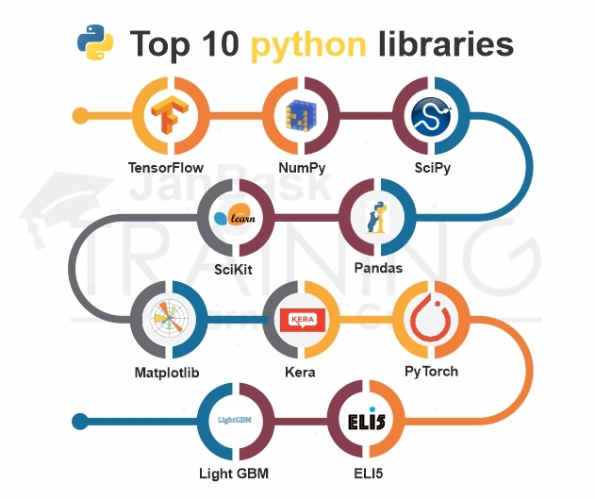
Notes:
They are available to inspire future learning

Slide 7
Examples Applications of Python in Business
Marketing Analytics
Portfolio Analysis
Business Process Analytics
AB Testing
Time Series Analysis / Forecasting
Quantitative Risk Management
Credit Risk Modeling
Human Resources Analytics
Customer Segmentation Analysis

Slide 8
Open your notebooks!
Brought to you by the Business Career Hub
TRS 2-148 | 416 - 979 - 5106
trsmcareers@ryerson.ca
www.ryerson.ca/trsmcareers

